Slide 1

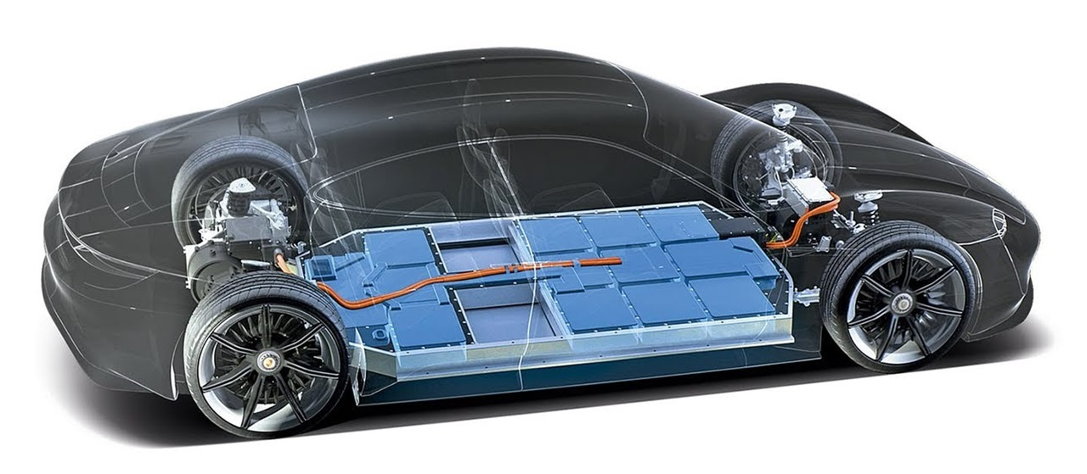
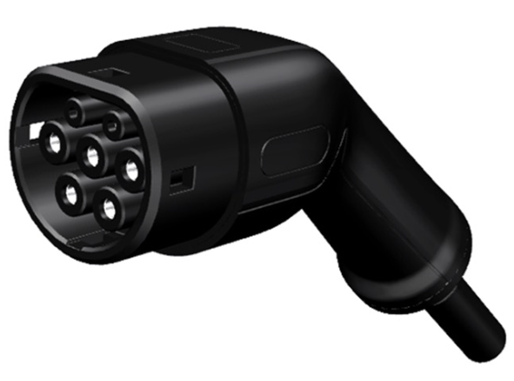
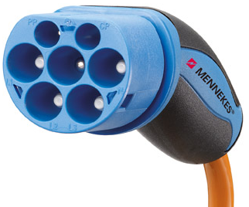
parameter
Uncertainty Scenarios
Battery Fault Diagnosis (Normal / Abnormal)
Unpredictable EV Behavior (Defy Plug in/out schedule)
EV Accumulated Penalty Score
EV Charger Type (AC 5pin / AC 7pin)
EV
EV Configuration
Battery Status (Binary)
Battery Capacity
SOC
EV Plug in/out Information
EV Spec
Init SoC
Target SoC
Battery Capacity
In-time
Out-time
Other Model
EV Model Output
Aggregator Output
Uncertainty
Error rate
EV Connection
Communication
Hardware error
input
Result
Charging singal
Discharging signal
Voltage & current
Final SoC
To Aggregator
Plug in/out event
Battery statue
EV Battery Diagnosis
EV Charger Type
output
Normal
or
Abnormal
AC_5pin
AC_7pin
input
Day | ID | cap | init | target | in | out | Pmin | Pmax | Error rate | Connection Err | Communication Err | Hardware Error
0 | EV0 | 72.6 | 0.8 | 0.75 | 14 | 36 | -5 | 11 | 0 | 1 | 0 | 0
0 | EV1 | 72.6 | 0.8 | 0.75 | 9 | 16 | -5 | 11 | 7 | 0 | 0 | 0
0 | EV2 | 72.6 | 0.4 | 0.75 | 18 | 20 | -5 | 11 | 20 | 0 | 0 | 1
0 | EV3 | 72.6 | 0.6 | 0.75 | 21 | 43 | -5 | 11 | 10 | 0 | 1 | 0
0 | EV4 | 72.6 | 0.4 | 0.75 | 10 | 30 | -5 | 11 | 5 | 0 | 0 | 0
0 | EV5 | 72.6 | 0.4 | 0.75 | 15 | 39 | -5 | 11 | 3 | 0 | 0 | 0
0 | EV6 | 72.6 | 0.3 | 0.75 | 19 | 33 | -5 | 11 | 0 | 1 | 0 | 0

Slide 2
Simulator
Input
Output
Aggregator
Plug-in/out event
Battery Spec
(SoC, SoH)
Charging Strategy
EV Connection Error
Plug-in SoC / time Error
Plug-in time error
EVCS
(Station)
Communication time error
Uncertainty
Plug-time
Battery Info
Charging Strategy
Target SoC
Plug-in SoC
EVs

Slide 3

EV parameter
Uncertainty Scenarios
Battery Fault Diagnosis (Normal / Abnormal)
Unpredictable EV Behavior (Break Plug in/out schedule)
EV Accumulated Penalty Score
EV Charger Type (AC 5pin / AC 7pin)
EV
EV Configuration
Battery Status (Binary)
Battery Capacity
SOC
EV Plug in/out Information
EVCS
Battery Fault Diagnosis
Unpredictable EV Behavior
1PM
2PM
3PM
4PM
5PM
In schedule
Diagnose Battery
1PM
2PM
3PM
4PM
5PM
Normal or Abnormal
At real

